Slide 1
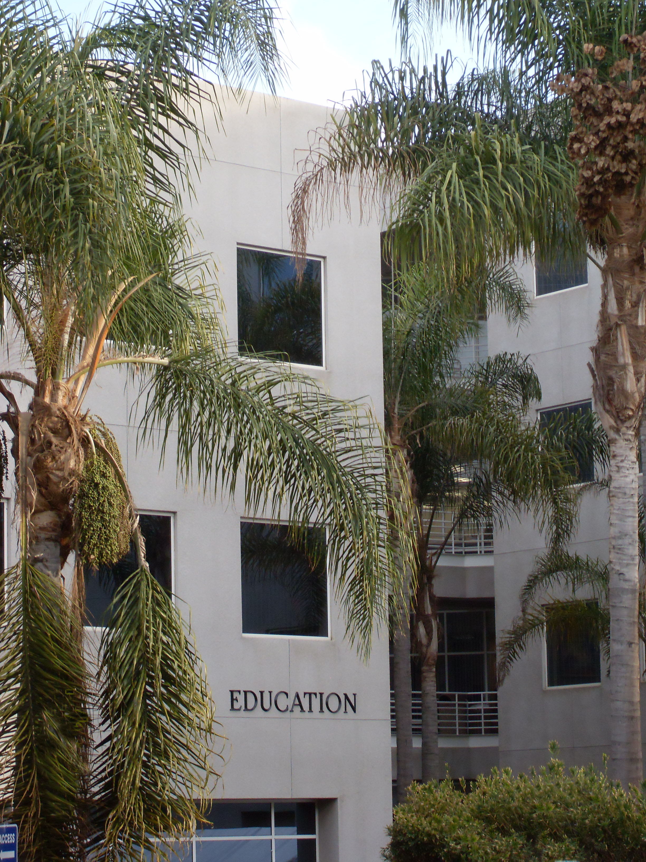
Video Analisi e Sviluppo Professionale dei Docenti Evidenze e prospettive dalla ricerca internazionale
Rossella Santagata
University of California, Irvine

Slide 2
How can we re-envision university teaching?
This Photo by Unknown Author is licensed under CC BY-NC
Notes:
Central question: how do we move from a university classroom where the teacher does most of the talking and students sit quietly to a classroom where students are invited to contribute to the construction of knowledge, learn from each other with the teacher as a facilitator and maybe even utilize technology to support their learning?
Nel percorso di oggi proporro la video analisi come un approccio promettente per introdurre innovazione nella didattica universitaria.

Slide 3
Video
Professional vision/noticing
Noticing verso l’inclusivita`/scuola democratica
Formazione e strumenti per valutare le competenze di noticing
Future direzioni di ricerca

Slide 4
Video e Visione Professionale

Slide 5
Affordances of Video
Slows down the teaching process, allowing viewers to unpack interactions from multiple perspectives
Captures viewpoints and interactions that teachers might not have access to during teaching
Captures materiality and spatiality, movement, relationships between human activity and objects in the classroom
Can be shared and used as a tool for collective discussion and reflection on teaching
Notes:
Many have discussed the affordances of video for changing teaching
Here are a few that I see as particularly important

Slide 6
Zooming in
Teacher noticing captures what we focus on during the split seconds of classroom activity
Teachers’ beliefs and dispositions toward teaching and learning frame what teachers notice (Ball, 2011; Hand, 2012)
What teachers tend to focus on matters for their teaching quality and student learning (Kersting et al., 2012)
Awareness of one’s noticing can help improve teaching and student learning (Berliner, 2001; Erickson, 2007; Franke et al., 2001; van Es & Sherin, 2008)
Teacher Noticing
Notes:
Most research conducted in classroom settings has centered on what teachers see during teaching, how they make sense of what they see, and how they decide what to do next—this is the construct of teacher noticing

Slide 7
Quali spunti ci offrono le varie prospettive sul noticing?
Noticing
Processi cognitivi:
focalizzare l’attenzione, interpretare, rispondere
Aspetti socio-culturali:
Comunita` di pratica, artefatti, norme sociali e culturali
Noticing come disciplina:
Consapevolezza del proprio modo di vedere
Differenze novizi-esperti:
progettare la formazione tenendo conto di progressioni
König, Santagata, Scheiner, Adleff, Yang, & Kaiser (2022). Teacher noticing: A systematic literature review of conceptualizations, research designs, and findings on learning to notice, Educational Research Review, Vol. 36 https://doi.org/10.1016/j.edurev.2022.100453

Slide 8
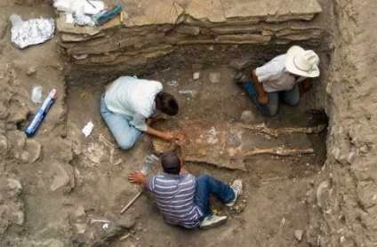
Professional Vision
Goodwin (1994)
“ways of seeing and understanding events that are answerable to the distinctive interests of a particular social group” (p.606)
Seeing as social practice, situated in socio-cultural context

Slide 9
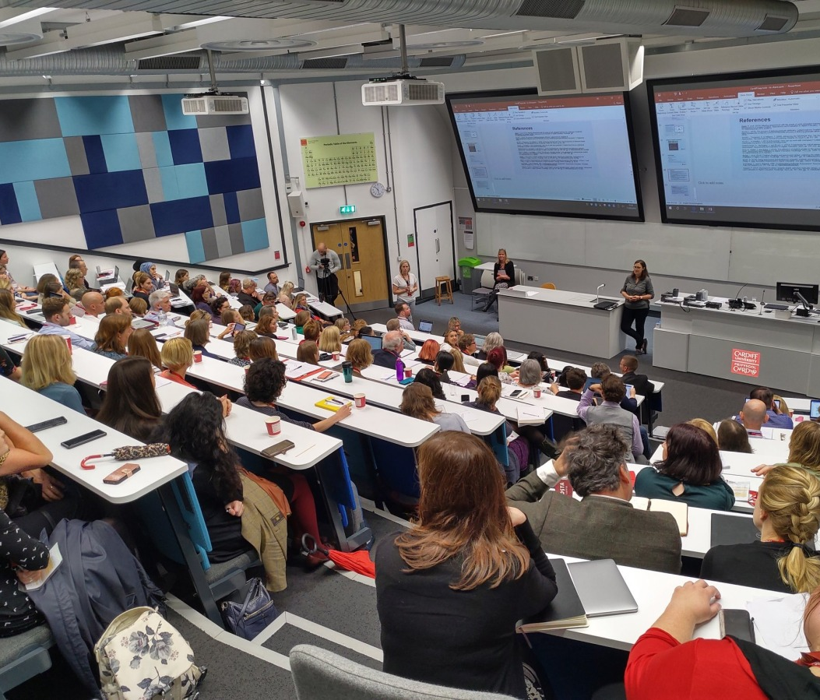
Who are we here to serve? And for what purposes? How do our classrooms serve the equity goals that should be the foundations of a truly democratic university?
How do our history and cultural lenses limit what we see and the opportunities for democratic spaces we might create in our university classrooms?
This Photo by Unknown Author is licensed under CC BY-NC
Notes:
What I find most powerful about the construct of professional vision is that it pushes us to ask questions about the purpose of what we do as teachers in university settings—what we try to achieve in the classroom. Our broader goals, our vision, drive our decisions and what we choose to see. What we highlight about a situation and how we make sense of it.
The opening of borders, the mixing of cultures and ways of being, pushes us to confront the hard questions –who are we here to serve and for what purposes? How do our classrooms serve the equity goals that should be the foundations of a truly democratic university?
How do our history and cultural lenses limit what we see and the opportunities for democratic spaces we might create in our university classrooms?
This vision also drives ways we zoom in ---

Slide 10
Noticing Processes
Identifying what is relevant in a classroom situation (van Es & Sherin, 2002)
Making connections between what is observed and larger principles of teaching-learning, and using what is known about the context to reason about what occurred (van Es & Sherin, 2002).
Responding/making decisions (Jacobs et al., 2010)
Shaping interactions to obtain information that supports reasoning about the event (van Es & Sherin, 2021)
Notes:
Different authors have highlighted and examined different facets or components of noticing

Slide 11
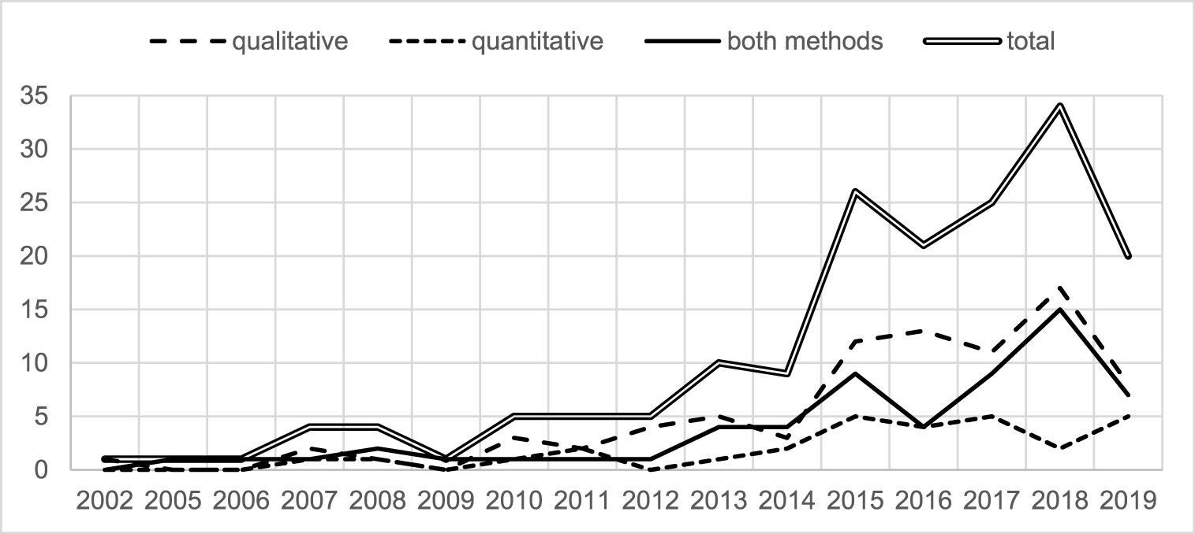
Research on teacher noticing: historical perspective
König, Santagata, Scheiner, Adleff, Yang, & Kaiser (2022). Teacher noticing: A systematic literature review of conceptualizations, research designs, and findings on learning to notice, Educational Research Review, Vol. 36
https://doi.org/10.1016/j.edurev.2022.100453
Notes:
What do we know about noticing?
172 empirical papers
103 (53%) of the authors are from North America, 70 (36%) from Europe, 13 (7%) from Asia, 7 (4%) from Oceania, and 2 (1%) from South America. We did not find any articles authored by scholars from Africa.
empirical research on teacher noticing has proliferated over the past decade, with the majority of studies (i.e., 34 studies) published in 2018. Since our database was created in June 2019, it underestimates the total number of papers published in 2019. Regarding the distribution of studies using the three different research designs, the number of qualitative studies and studies using qualitative and quantitative methods has increased, whereas the number of studies deploying quantitative methods only has not increased since 2015.
Of the 182 papers selected, 135 referred predominantly to the cognitive-psychological perspective of teacher noticing (74%), 35 (20%) referred predominantly to the socio-cultural perspective of teacher noticing, and only 12 (approximately 6%) referred to both perspectives.

Slide 12
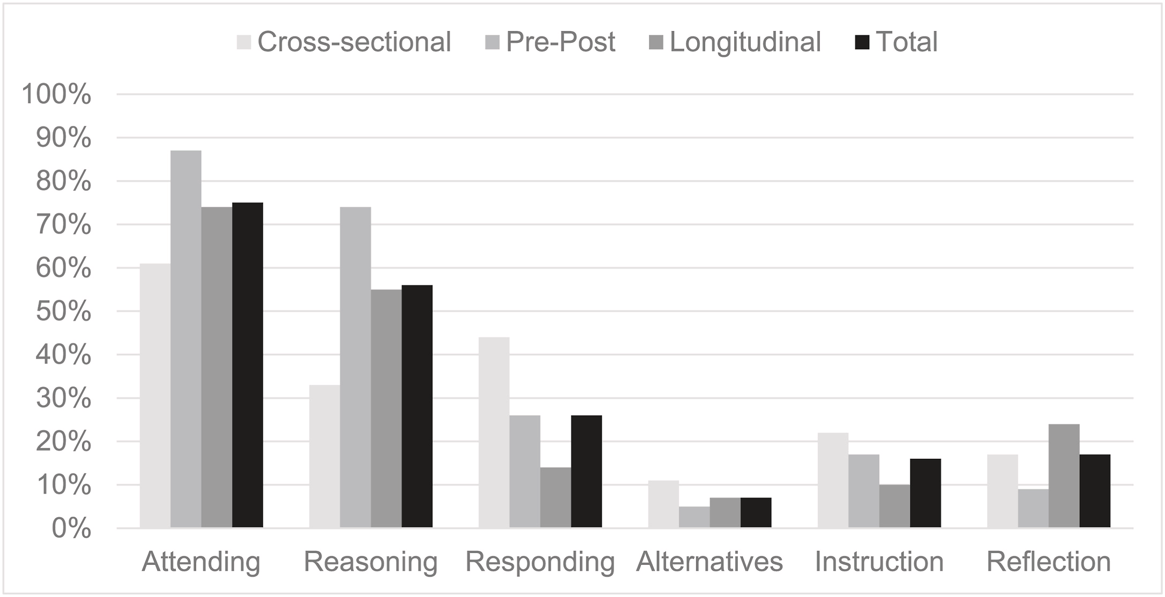
Research on teacher noticing: impact of interventions
König, Santagata, Scheiner, Adleff, Yang, & Kaiser (2022). Teacher noticing: A systematic literature review of conceptualizations, research designs, and findings on learning to notice, Educational Research Review, Vol. 36
https://doi.org/10.1016/j.edurev.2022.100453

Slide 13
Video and learning to notice in mathematics
Video is an effective tool to develop teacher noticing
The cognitive perspective is the most utilized (91% of studies)
Most studies focus on attending (89%) and interpreting (80%) and fewer on responding (37%)
Few studies (17%) examined impact on teaching quality
Only 26% have used a software to guide teacher noticing and only 4 a video annotation software
Missing is design-based implementation research
Santagata, R., et al. (2021). Mathematics teacher learning to notice: A systematic review of studies of video-based programs. ZDM–Mathematics Education, 1-16.
Notes:
Additional notes:
Studies with pre-service teachers that inquired about how an intervention facilitated the development of noticing most frequently employed qualitative approaches (82%, n = 9), while studies with in-service teachers were about evenly split between qualitative and use of both qualitative and quantitative approaches (qualitative: 43%, n = 3; both approaches: 57%; n = 4).
The majority of studies asking about the impact of an intervention (to what extent) involved pre-service teachers (93%, n = 14). For pre-service teachers, these studies drew from a range of empirical approaches, most notably using both methods (57%, n = 8), qualitative (21%, n = 3), and quantitative (21%, n = 3). The one study that investigated the extent to which an intervention influenced in-service teachers’ noticing used a qualitative approach.

Slide 14
Noticing for Equity

Slide 15
Emerging Research on Noticing for Equity
Noticing for equity as a central component of ambitious and equitable teaching (e.g., Hand, 2012; McDufﬁe et al., 2014; Turner et al., 2012; Wager, 2014).
Equitable teachers attend to student thinking, but also to (van Es, Hand, & Mercado, 2017):
status and positioning
individual student histories both within and beyond the class
energy and ﬂow of the students and the class
Notes:
status and positioning
- how groups function and how students support one another in group work; who is participating and taking the ﬂoor during whole class discussion and how different forms of student participation afford opportunities for others’ learning; and how the teacher constructs opportunities for students to take up space.
energy and ﬂow of the students and the class
- That is, they noticed how and when students took up ideas, when students sought to move conversations in a new direction, and when students could sustain mathematical inquiry or needed to take a pause and reengage.

Slide 16
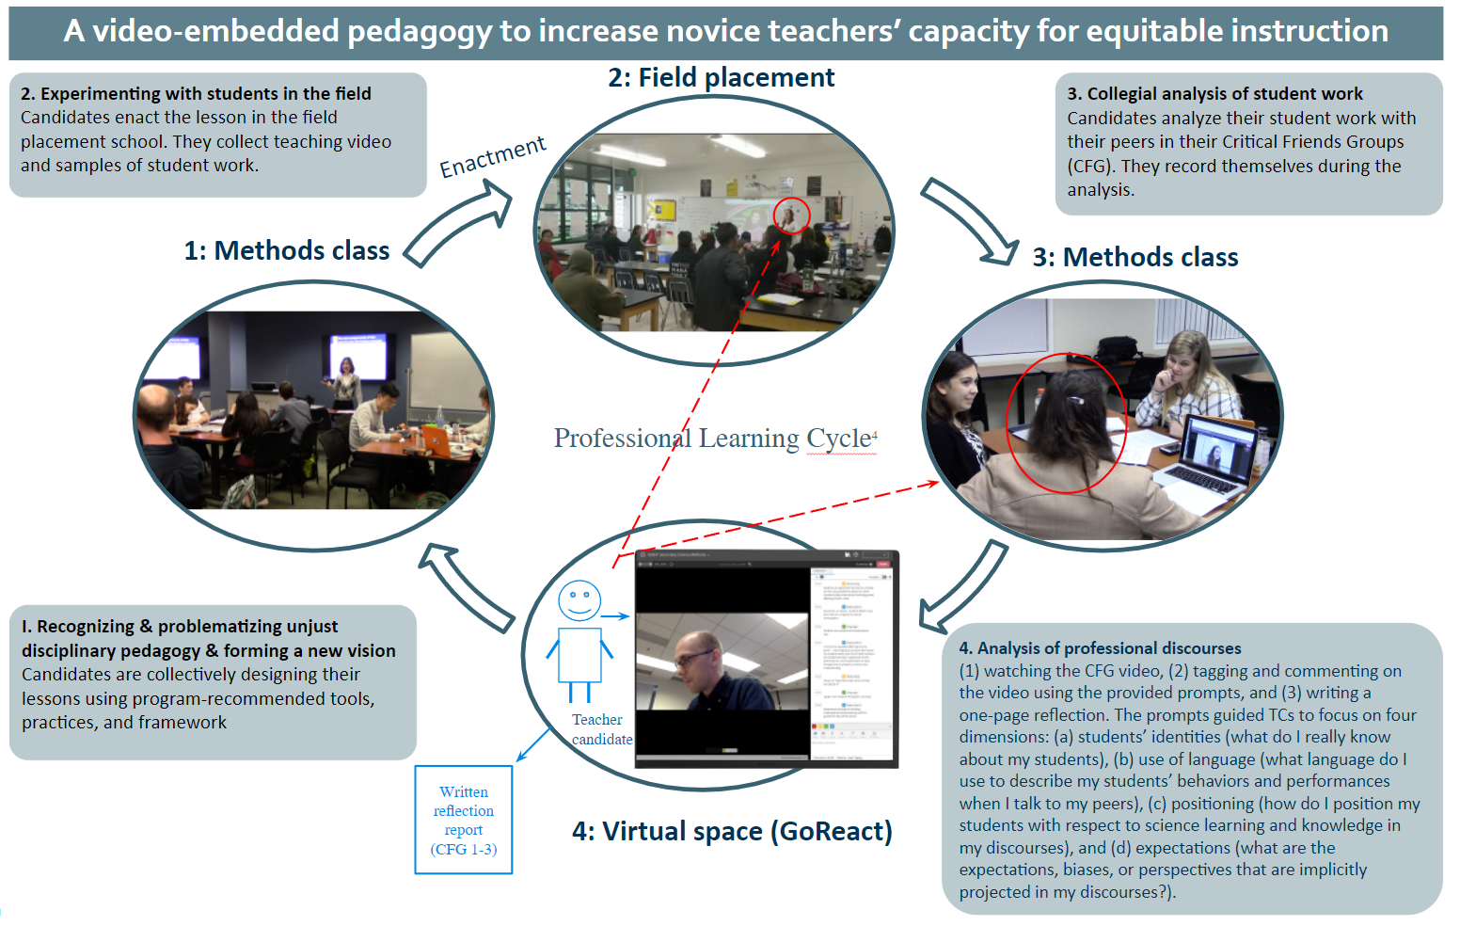
Kang & Lee, 2022

Slide 17
What do you Notice?
On St. Patrick’s day, Megan found 4 gold coins. Megan’s brother, Ryan, found some, too. If they found 10 coins altogether, how many gold coins did Ryan find?
Guardate questa clip e scrivete due cose che notate

Slide 18
What should be the focus of teacher noticing?
Teachers tend to focus on broad features of effective instruction
Positive classroom climate
Classroom management and organization
Lesson clarity
Tend to focus less on other features of classrooms that matter for student learning
Student thinking in a lesson
Student difficulties
Student questions
Student disciplinary engagement

Slide 19
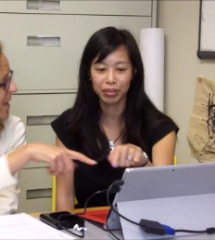
Noticing e Formazione dei Docenti

Slide 20
Analysis of Practice
From noticing in the midst of instruction
to reflection/analysis
Attending to important elements of
instruction also prior to and after teaching
(Santagata & Guarino, 2011)
Treating lessons as experiments
(Hiebert, Morris, & Glass, 2003)
Instruction
Reflection
Planning

Slide 21
Lesson Analysis Framework
Equity Lenses
Attending to initial understandings/asset lens
Attending to access and opportunities to participate
Analyzing Teaching
What is the main goal of the instruction episode?
Which teaching strategies helped students to make progress toward the learning goal? Which didn’t? Why?
What progress did students make toward the goal? What evidence do you have? What evidence is missing?
How can instruction be improved? What are the next steps?

Slide 22
Lesson Analysis Framework: Research Evidence Santagata, et al., 2007; Santagata & Angelici, 2010; Santagata & Guarino, 2011; Santagata & Yeh, 2014; Yeh & Santagata, 2015; Santagata, Yeh, & Mercado, 2018
WHO? Prospective and practicing teachers; primary and secondary teachers
WHERE? Italy, Switzerland, the Unites States
WHAT DID TEACHERS LEARN? Teachers learned to:
attend to details of student thinking and math content
elaborate and interpret
propose alternative teaching strategies
attend to student thinking during teaching and in self-reflection
make justified claims based on evidence of student learning to discuss effectiveness of teaching
learn from teaching with long-term knowledge improvement

Slide 23
Come si valutano le competenze di noticing?

Slide 24
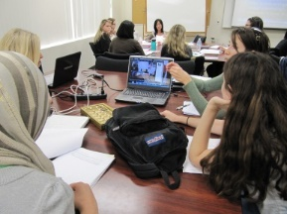
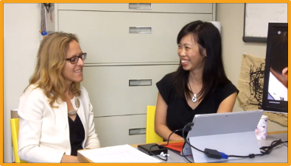
Measuring Noticing
In the midst of instruction
After instruction
Noticing interviews (Sherin & van Es)
Eye tracking (Yamamoto & Imai Matsumura)
Wearable camera (Sherin, Russ, & Colestock)
Noticing interviews (Sherin, Van Es, Stockero)
Transcripts of teacher group conversations (Sherin & van Es; Kazemi)
Written analyses of practice (Jacobs, Lamb, & Philipp; Santagata, Zannoni, & Stigler)
Validated assessments (Kersting; Seidel)

Slide 25
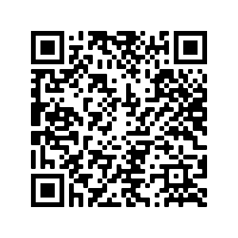
Review of Noticing Instruments
22 different instruments
37 articles (since 2008)
European scholars (25), North American (10), Asian (2)
Research design:
Cross-sectional (22)
Pre-post test designs (15)
Participants:
Pre-service (28)
In-service (15)
Weyers, J., König, J. Santagata, R., Scheiner, T., & Kaiser, G. (under review)
Teacher noticing: A systematic literature review on measurement instruments
Notes:
Of the 37 articles included in this systematic literature review, the earliest was published in 2008. Most were published by European scholars (25), while the remainder were written by scholars from North America (10) and Asia (2), including a collaboration between Chinese and European scholars (Yang et al. 2019). Cross-sectional designs (22), pre‑post designs (15), and one longitudinal design with more than two measurements (Stürmer et al. 2016) were reported. The surveyed samples included pre-service teachers in 28 articles and in-service teachers in 15 articles, with seven articles including both pre- and in-service teachers.
Identification of test instruments
As our literature review focused on papers in the first step, some test instruments were used in multiple papers. In the second step, we analyzed the test instruments used and identified a total of 22 different test instruments, The publication by Seidel and Stürmer (2014) was counted twice because two studies were reported.
https://drive.google.com/file/d/1ucHLBhD4wz2zDPXvFDjpo9E4YNvLLDuC/view?usp=sharing

Slide 26
“Framework for Learning to Notice” (van Es, 2010)
LEVELS | 1. Baseline | 2. Mixed | 3. Focused | 4. Extended
COSA notano? | Tutta la classe, disciplina | Approccio pedagogico dell’insegnante | Particolari aspetti del pensiero degli alunni | Particolari aspetti del pensiero degli alunni e relazione tra insegnamento ed apprendimento
COME notano? | Impressioni generali Commenti descrittivi e valutativi Nessuna evidenza | Evidenzia momenti importanti Commenti valutativi con qualche interpretazione Comicia a riferirsi a momenti specifici e ad interazioni | Evidenzia momenti importanti Commenti interpretativi Elabora su momenti ed interazioni specifiche | Evidenzia momenti importanti Commenti interpretativi Elabora su momenti ed interazioni specifiche Connessione a principi di apprendimento e proposta di soluzioni pedagogiche alternative
Notes:
In questo ambito la mia college Elizabeth van Es ha sviluppato questo framework che viene utilizzato molto nella formazione per esaminare diversi livelli di qualita` di cio che gli insegnanti notano e di come notano.

Slide 27
Classroom Video Analysis (CVA) https://sites.google.com/site/teknoresearchsite/research-design
Short video clips chosen based on key math concepts and (a) whole-class and (b) teacher-student interactions.
Open prompt: View the video clip and discuss how the teacher and the student(s) interact around the mathematical content.
Written comments are scored (0, 1, 2) according to a multi-dimensional rubric:
Elaboration
Math content
Student thinking
Suggestions for improvement
Validated instrument; studies show predictive value of scores for student learning
Kersting et al, 2010; 2012

Slide 28
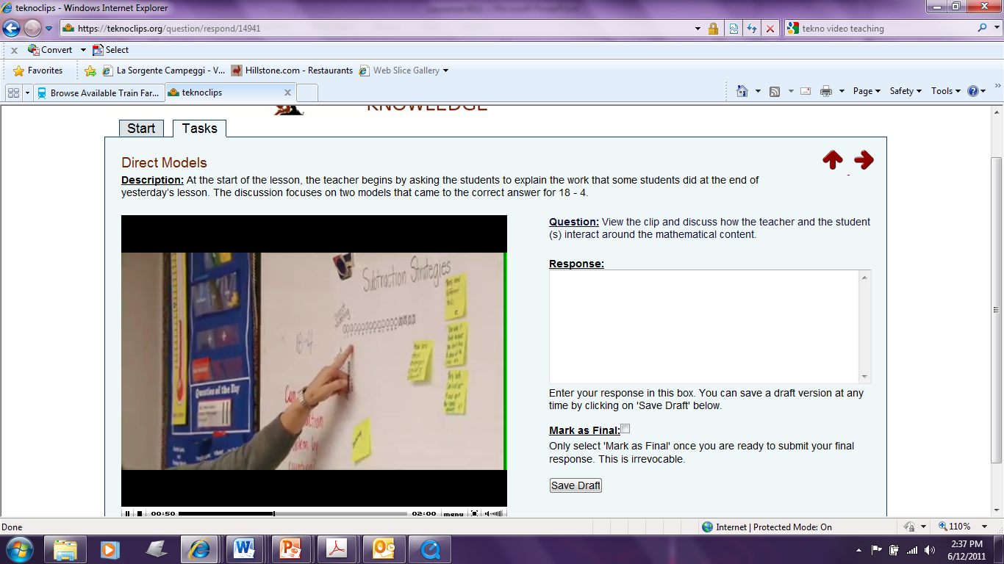

Slide 29
CVA Dimensions of Usable Knowledge
Dimension | 0 | 1
Math Content | Not included | Math visible in the clip | Includes math ideas not visible in the clip
Student Thinking | Not included | Analysis of student thinking as it relates to mathematics | Student math thinking is explained, synthesized, or generalized
Suggestion for Improvement | Not included | Clear suggestion for improving math learning | Clear suggestion linked to specific mathematics
Depth of Interpretation | Descriptive comments | Substantiated interpretation | Several substantiated interpretations
2
Notes:
ST: Concern for student thinking/understanding usually takes the form of either a judgment about student(s) understanding or as a comment on the opportunities to learn students were afforded in the clip. Concern for student thinking/understanding requires some evidence, in form a rationale, based on which the judgment is made.
Responses receive the highest score (2) when either (a) the respondent also ties in new (un-observable) math to their remark(s) about student thinking/understanding or the respondent insightfully synthesizes the student thinking with the mathematical content at multiple steps in the clip.
Similarly for suggestions for improvement
Sample responses are typically the best way to illustrate the differences in the quality of the responses

Slide 30
How do YOU notice?
On St. Patrick’s day, Megan found 4 gold coins. Megan’s brother, Ryan, found some, too. If they found 10 coins altogether, how many gold coins did Ryan find?
Tornate agli appunti che avete preso prima sul video.
Che punteggio vi dareste?

Slide 31
Dimensions of Usable Knowledge
Dimension | 0 | 1
Math Content | Not included | Math visible in the clip | Includes math ideas not visible in the clip
Student Thinking | Not included | Analysis of student thinking as it relates to mathematics | Student math thinking is explained, synthesized, or generalized
Suggestion for Improvement | Not included | Clear suggestion for improving math learning | Clear suggestion linked to specific mathematics
Depth of Interpretation | Descriptive comments | Substantiated interpretation | Several substantiated interpretations
2
Notes:
ST: Concern for student thinking/understanding usually takes the form of either a judgment about student(s) understanding or as a comment on the opportunities to learn students were afforded in the clip. Concern for student thinking/understanding requires some evidence, in form a rationale, based on which the judgment is made.
Responses receive the highest score (2) when either (a) the respondent also ties in new (un-observable) math to their remark(s) about student thinking/understanding or the respondent insightfully synthesizes the student thinking with the mathematical content at multiple steps in the clip.
Similarly for suggestions for improvement
Sample responses are typically the best way to illustrate the differences in the quality of the responses

Slide 32
Future direzioni di ricerca

Slide 33
Promises and Challenges of Using Video to Develop University Teachers’ Competencies
Promises
Challenges
Build on existing theoretical frameworks and empirical research
Global attention and awareness of importance of high-quality university instruction
Inclusive and diverse university requires a new vision
Culturally and historically ingrained ways of doing university teaching
Competing tasks of university professors

Slide 34
Noticing and Didattica Universitaria: la Ricerca
Chiarire prospettiva teorica
Progettare la formazione con attenzione agli obiettivi d’apprendimento e gli aspetti del noticing/professional vision sui cui ci si vuole soffermare
Includere gia` dalle fasi iniziali misure sugli effetti della formazione sulle practice didattiche
Avvalersi della tecnologia con utilizzo di software che permettano di annotare i video e collaborare alla loro interpretazione
Soffermarsi sulla didattica inclusiva nel contesto universitario e su quale funzione il noticing possa avere in questo ambito
Notes:
Cosa possiamo trarre da questi risultati che puo` essere rilevante nella ricerca sul noticing in campo universitario?
Condivido alcune mie riflessioni iniziali

Slide 35
Per Saperne di Piu`
http://faculty.sites.uci.edu/santagata/
https://www.researchgate.net/profile/Rossella_Santagata
Intervista INDIRE: https://www.youtube.com/watch?v=BEjHAlq7MpM&feature=youtu.be
Email: r.santagata@uci.edu

Slide 36
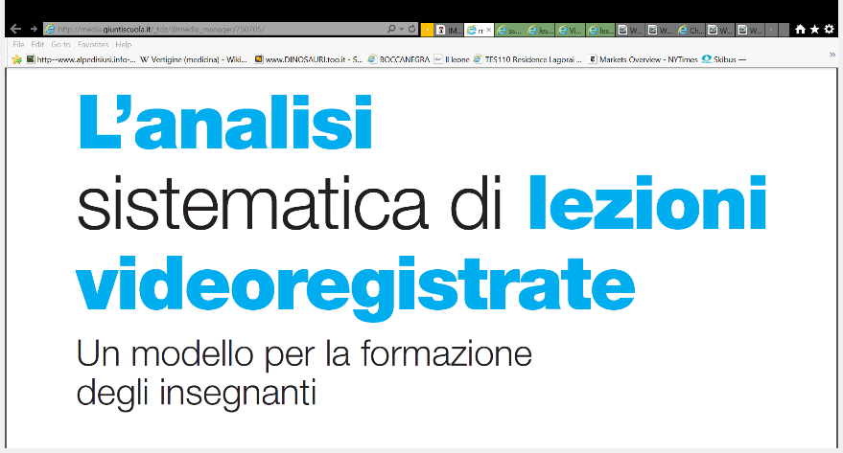
In Italiano
Articolo pubblicato in Psicologia e Scuola, novembre-dicembre 2010
http://media.giuntiscuola.it/_tdz/@media_manager/750705/

Slide 37
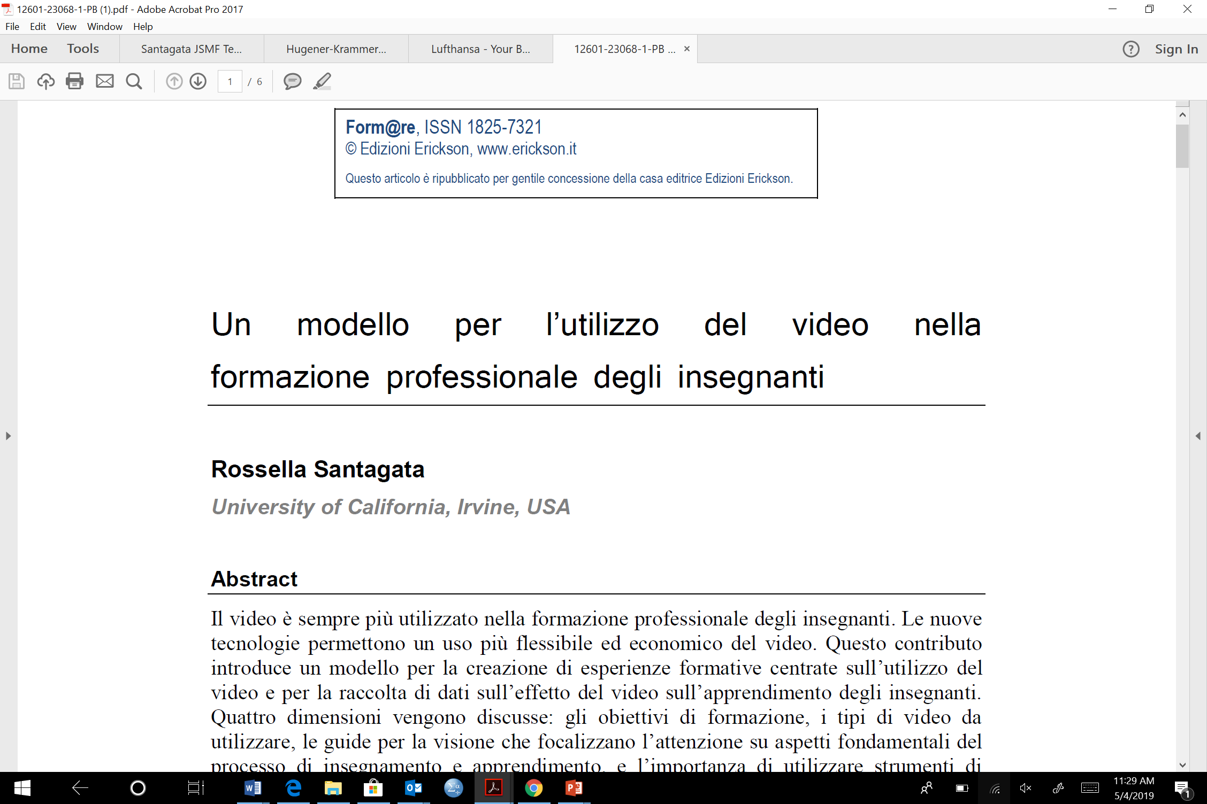
Un modello per l’Utilizzo del Video nella Formazione degli Insegnanti
http://www.fupress.net/index.php/formare/article/view/12601/11933

